Slide 1

ORDER PROCESSING SYSTEM

Slide 2
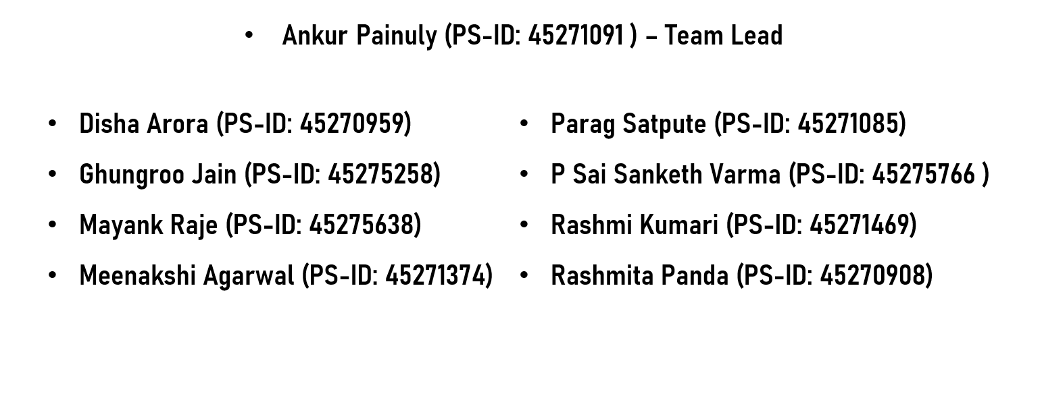
Group Members

Slide 3

Web-based application for processing orders and generating an invoice.
OP
ORDER PROCESSING SYSTEM
Invoice generated includes the GST on the products as well as the shipping costs; and are calculated automatically.
Easy creation , approval and invoice of quotes for the customers.
Shipping cost calculated based on order value and product.
Code Fury Project
Application is Object Oriented and easily extensible to add new features or other use cases.
Products can be imported using a JSON file and added to the database after validation.

Slide 4
Login
Order Management
MODULES
Quotes Approval
Order Processing System
Import Products
Invoice Generation
New Quote Creation

Slide 5
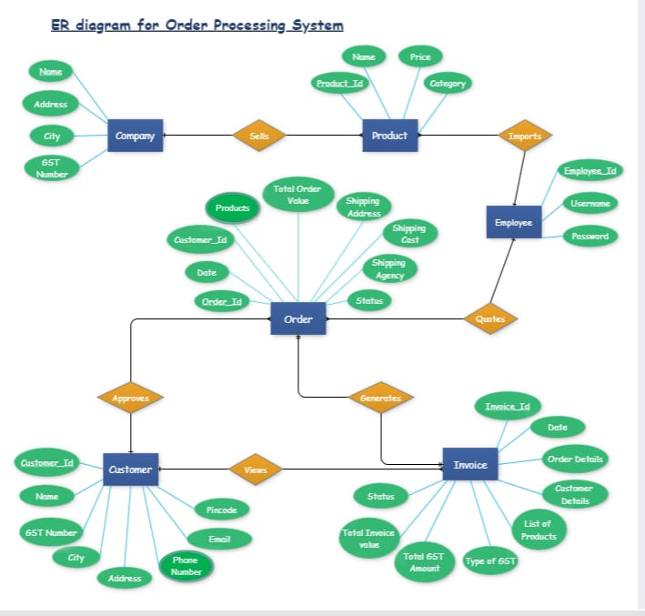
ER Diagram

Slide 6
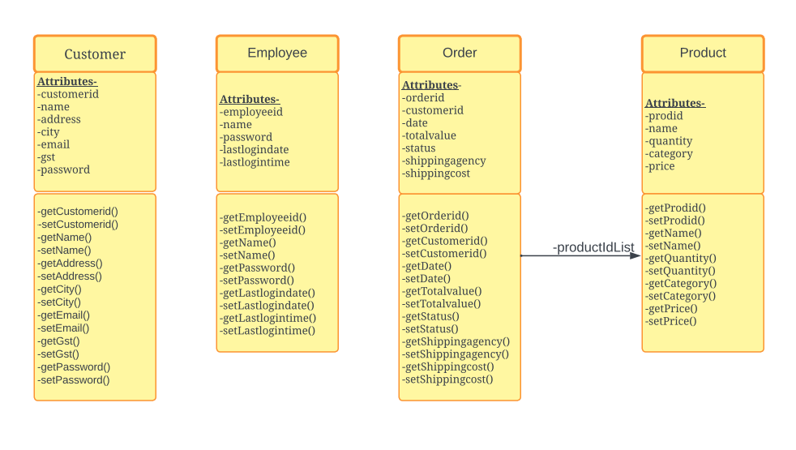
Class Diagram

Slide 7
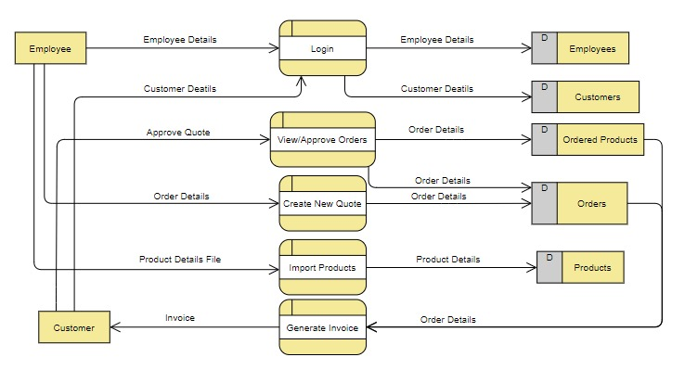
Data Flow Diagram

Slide 8
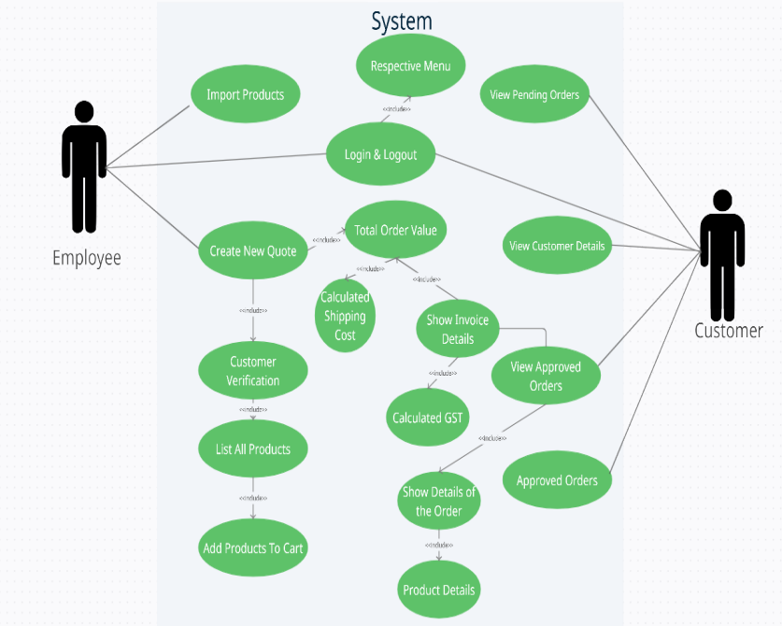
Use Case Diagram

Slide 9
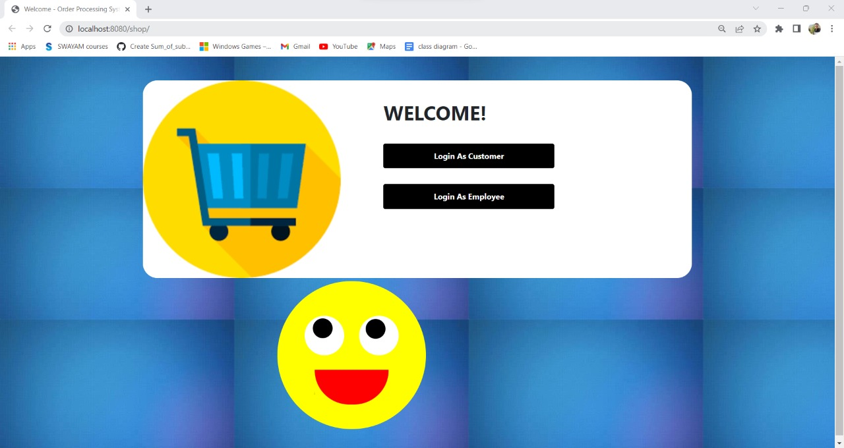
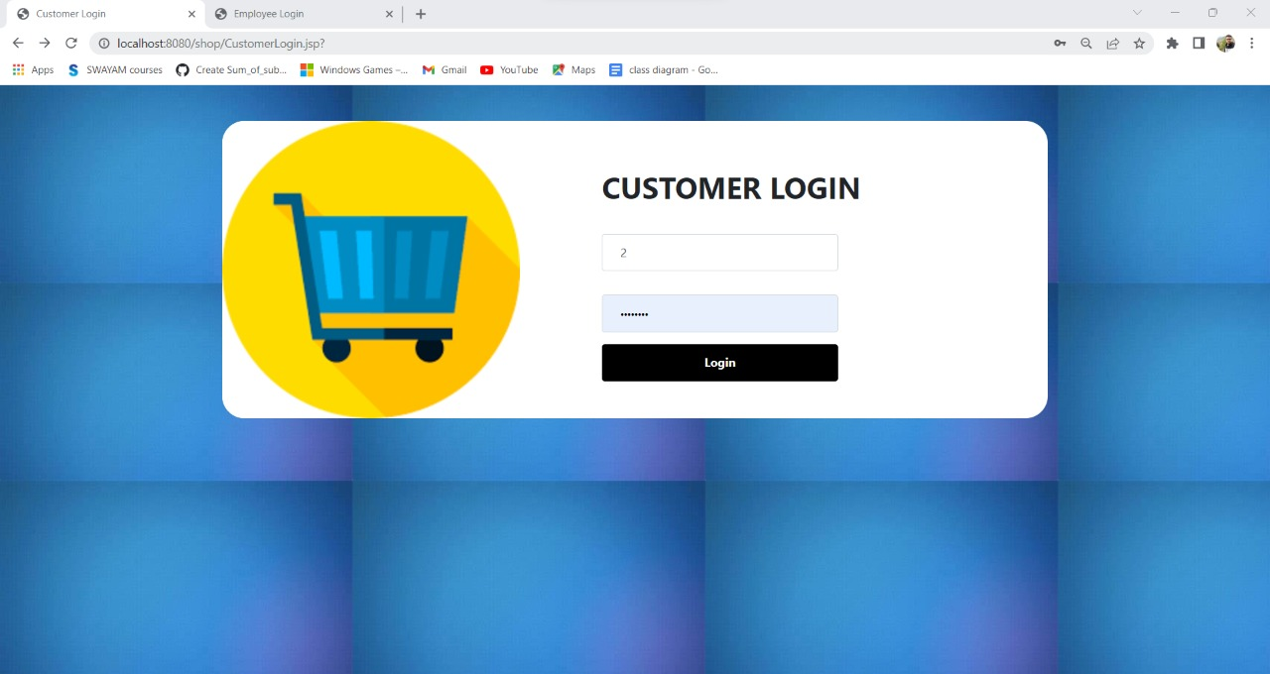
Customer Login Screen
Home Screen

Slide 10
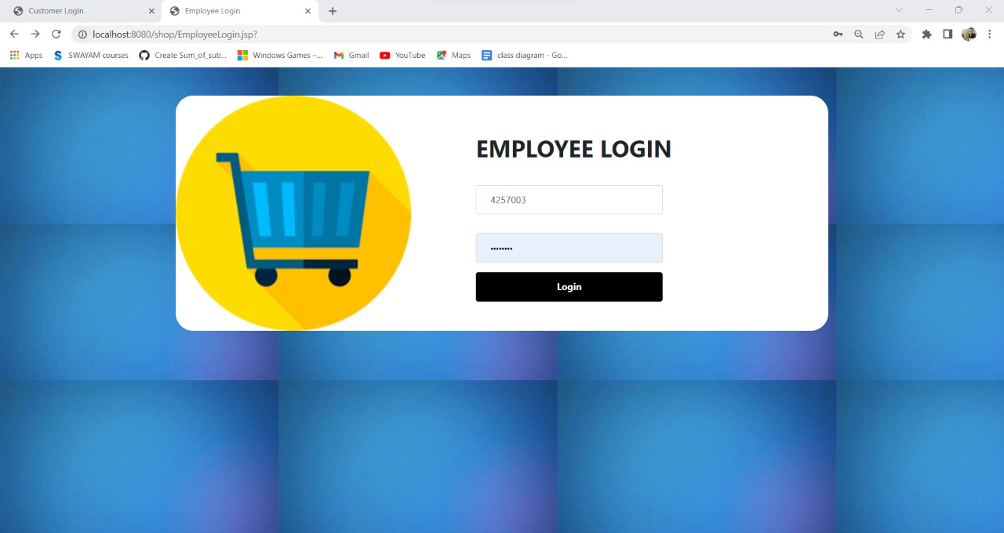
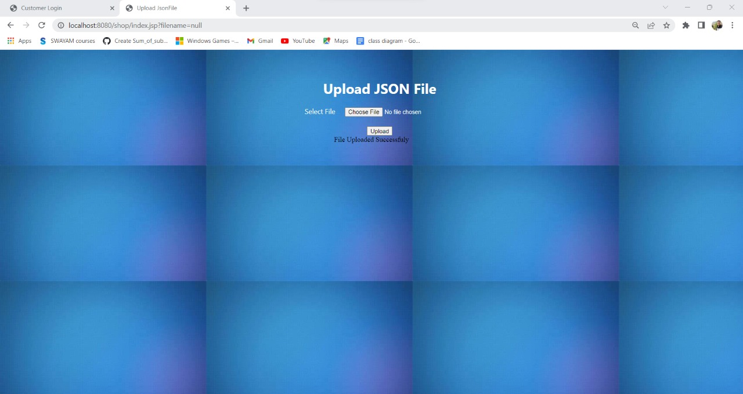
Upload JSON Screen
Employee Login Screen

Slide 11
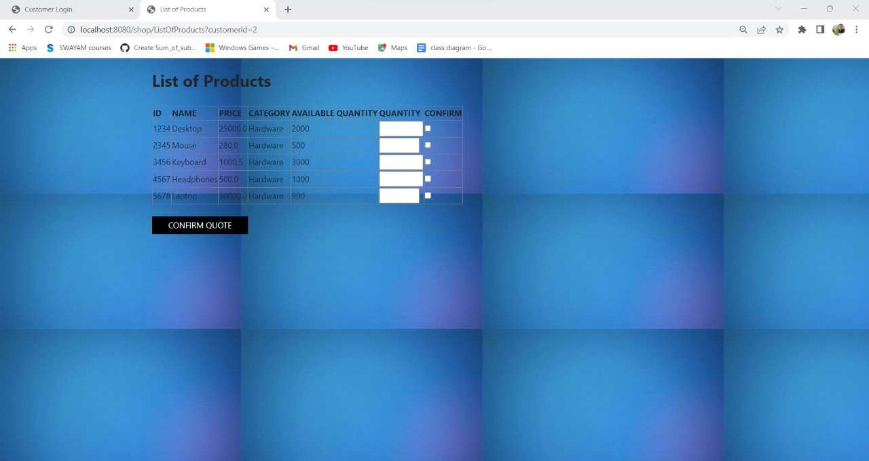
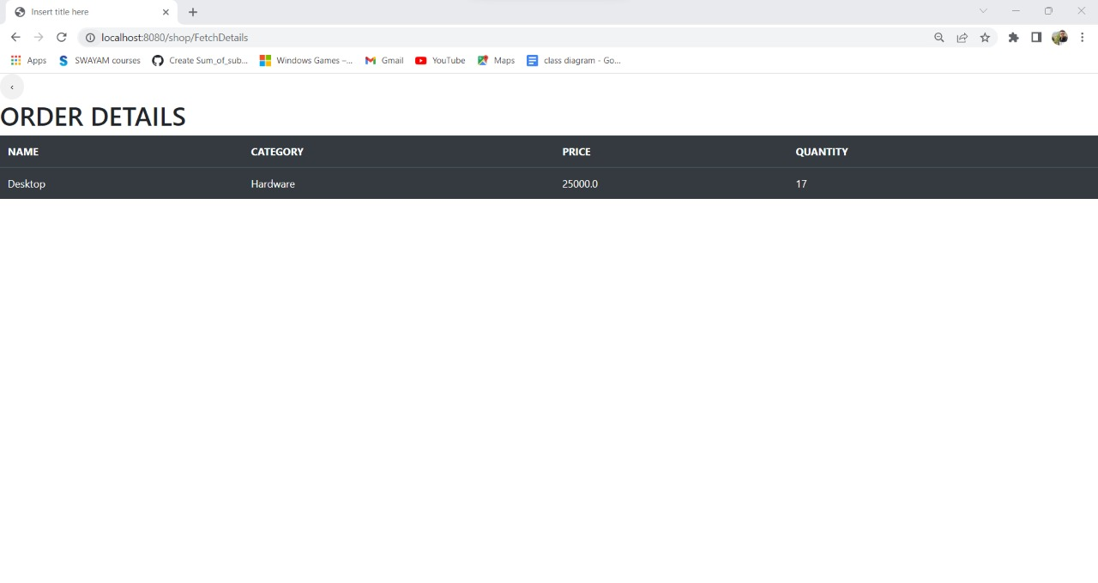
Product Detail Screen
Create Quote Screen

Slide 12
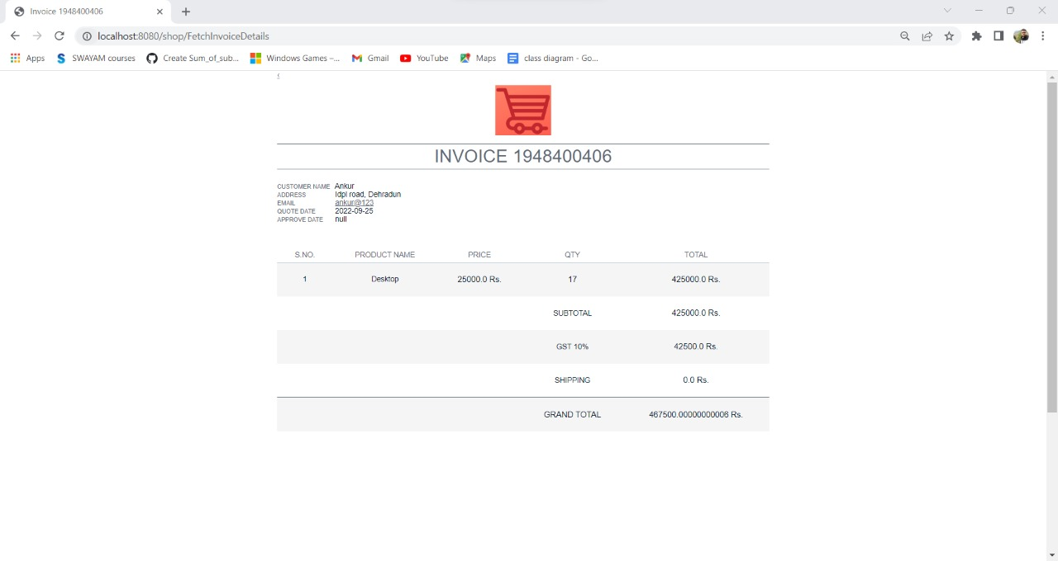
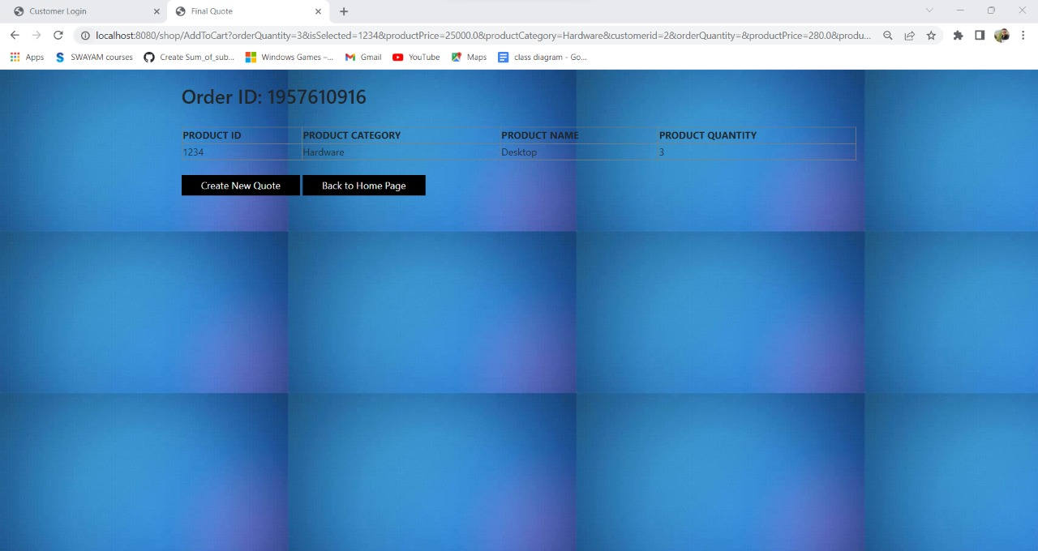
Order Screen
Product Invoice Screen

Slide 13
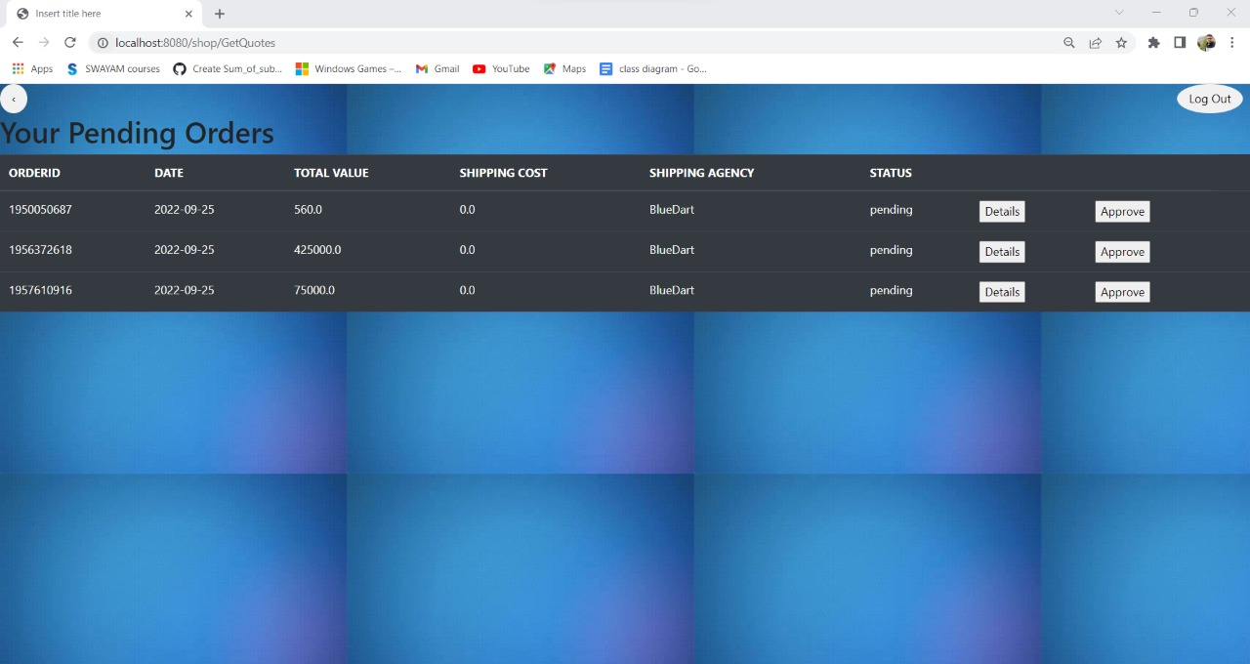
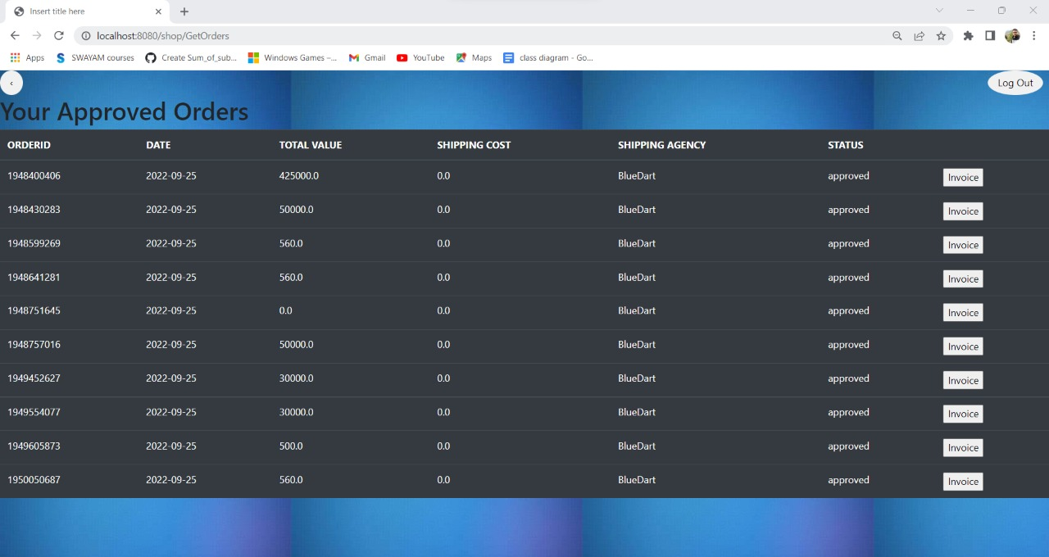
Customer Approved Orders Screen
Customer Pending Order Screen

Slide 14

Project Life Cycle
Initiation and understanding the project.
Brainstorming and requirement analysis.
ORDER PROESSING SYSTEM
Modular approach.
Implementation and coding.
Testing.
Documentation.

Slide 15
THANK YOU!!

